Slide 1
Fullstack 30 hari
Rangkuman Cepat

Slide 2
DAY
HARI PERTAMA 1.1
1
Urutan Daily
Setup Project
1.Buat Folder Project
2.Jadikan Git Repo
3.Buat .gitignore
4.BuatREADME
Folder Project
GIT
5.Hubungkan ke Github
6.Commit & push Github
React
GIT HUB

Slide 3
Tahapan 1
Set up Project
2.Jadikan Folder Git Repo
1.Buat Folder Project
3.Buat File .gitignore
Buka Terminal
Buka Git bash
Mkdir fullstack-30hari
Cd fullstack-30Hari
Buka Terminal
Git Init
Git Status
Cd fullstack-30Hari
Buat File Didalam project
Isinya node_modules/ dist/ .env

Slide 4
Tahapan 1
Set up Project
5.Hubungkan Dengan GitHub
4.Buat File README
6.Commit & Push
Isi Dengan Target ketentuan
Remote File dengan github
Git Status
Git add .
Git commit –m “isi komen”
Git push origin main

Slide 5
Git INIT
Catatan Tahap 1
  GIT INIT = Mulai Mencatat Perubahan
Git STATUS
  GIT STATUS = Melihat Kondisi Repo
MKDIR
  mkdir = membuat folder.
Git Upload To Main
PWD
  Git add .
  Git commit –m “Komentar Kondisi”
  Git push origin main
  Menampilkan Lokasi Folder
CD Fullstack-30Hari
  Masuk Kedalam Folder
Git Remote
File .gitignore
  git remote add origin https://github.com/MuhammadRamdani121/Fullstack-30Hari.git
  Untuk Memberikan Perintah Jangan Dimasukan Ke repo

Slide 6


Slide 7
DAY
HARI PERTAMA 1.2
1
Urutan Daily
1.Membuat Fontend & backend Terpisah
Setup Frontend React
2.Membuat React dengan Vite
3.Buat .gitignore
4.Jalankan React
Frontend
Vite
Run
React

Slide 8
Tahapan 1
Set up Project
1.Membuat Frontend & backend Terpisah
2.Membuat Frontend dengan react melalui vite
3.Jalankan Vite
Frontend
Install React Vite
Menjalankan React
  UI & UX
Npm create vite@latest frontend
Framework : React
Variant : JavaScript
Npm run dev
Backend
  Database & API

Slide 9
Library
Catatan Tahap 1.2
  React
Fundamental – Library vs Framework vs tools
Framework
  Next.js & Express.js
  Library
  Kumpulan Kode yang sudah dibuat dan tinggal digunakan
  Framework
  Kumpulan Kerangka / cara kerja aplikasi yang sudah dibuat dan tinggal mengikuti struktur yang disediakan
Tools
  Vite
  Tools
  Membantu mengerjakan & menjalankan Project

Slide 11
Let’s warm up
Add a short physical or interactive activity to help students get ready for the day. You can include a timer or visual elements, too.

Slide 12

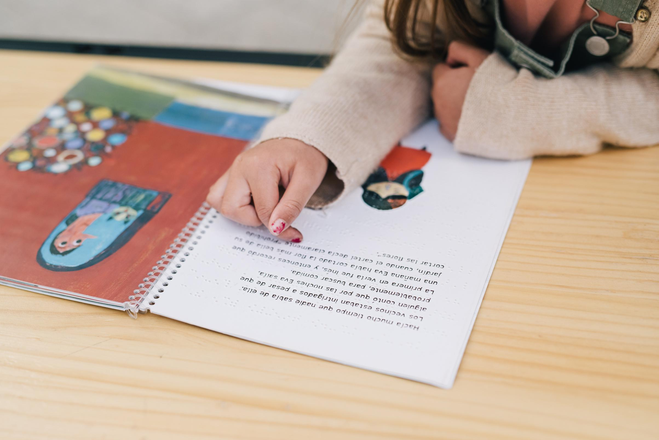

Book title
New words:
  List 2-3 words students will learn while reading.
Let’s think:
  Add 2-3 simple questions to guide reflection.
  These could focus on characters, setting, or events.

Slide 13



MATH
Let’s think in numbers

Slide 14

SCIENCE
Let’s understand how things work

Slide 15



Activity title
Let’s observe:
  Add a question to help learners observe or notice something during the activity.
Let’s ask:
  Include an open-ended question that encourages curiosity.

Slide 16




Activity title
Instructions
Our goal:
  Share the purpose of the activity.
Step 1:
Prepare the clay
Step 2:
Roll the clay
What we’ll use:
  List the materials that will be used.
Inspiration:
Step 3:
Add next step here.
Step 4:
Add next step here.
  Share an example or an inspirational piece.

Slide 17

Credits
  This presentation template is free for everyone to use, thanks to the following:
  for this presentation template
Pexels, Pixabay, Sketchify
  for the photos, graphics, and elements
  Happy designing!

Slide 18

ART
Let’s play and create

Slide 19





Resource Page
  Use these in your presentation. Delete or hide this page before presenting.
Fonts
Design Elements / Icons
This presentation template
uses the following free fonts:
TITLES:
Baloo
BODY TEXT:
Nunito Regular
You can find these fonts online too.
Colors
#ED7843
#ED7843
#ED7843
#ED7843
#ED7843

Slide 20


MONTH
HOMEROOM
8
DAY
What we’ll explore today
Class reminders
8:00
to
9:00
Homeroom
Add any important notes students need to remember for the day
9:00
to
10:00
Reading
10:00
to
11:00
Math
11:00
to
12:00
Lunch Break
Puzzle of the day
12:00
to
1:00
Science
Add a fun riddle, brain teaser, or puzzle to spark student thinking
1:00
to
2:00
Art

Slide 21



AWESOME JOB TODAY!

